Slide 1
Postal system Enhancement
Group 9
林原賢 施毅承 張為智 林柏仰

Slide 2
Preview
Before enhancement, Chunghwa Post Co. classifies letters or packages by seeing the ZIP code on them, and they are all done by human.
After enhancement, we change the ZIP code into an scan able barcode. After that all classification will be done in the program we design so this make the classification much faster than before.

Slide 3
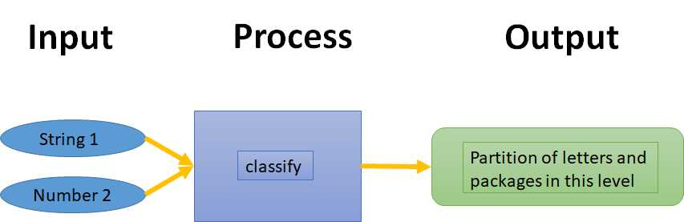
I-P-O cycle
String 1 ：ZIP code( 5 integers )
Number 2 ：the least digit we hope to classify(1~5)

Slide 4
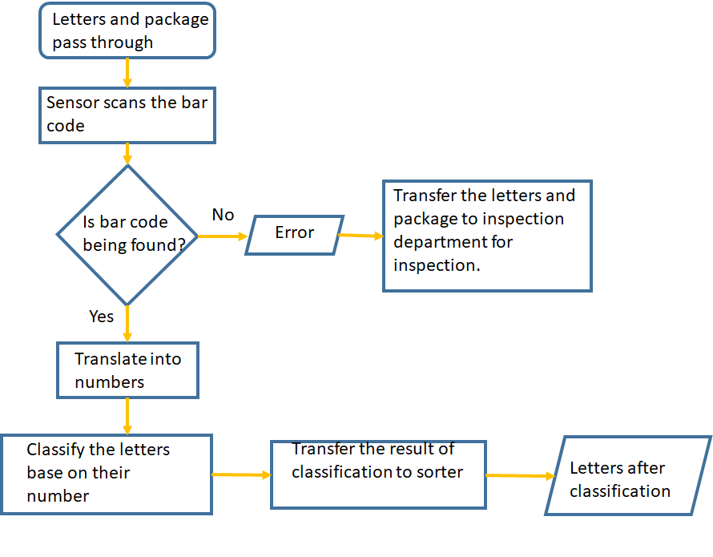
Flowchart

Slide 5
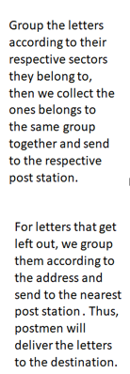
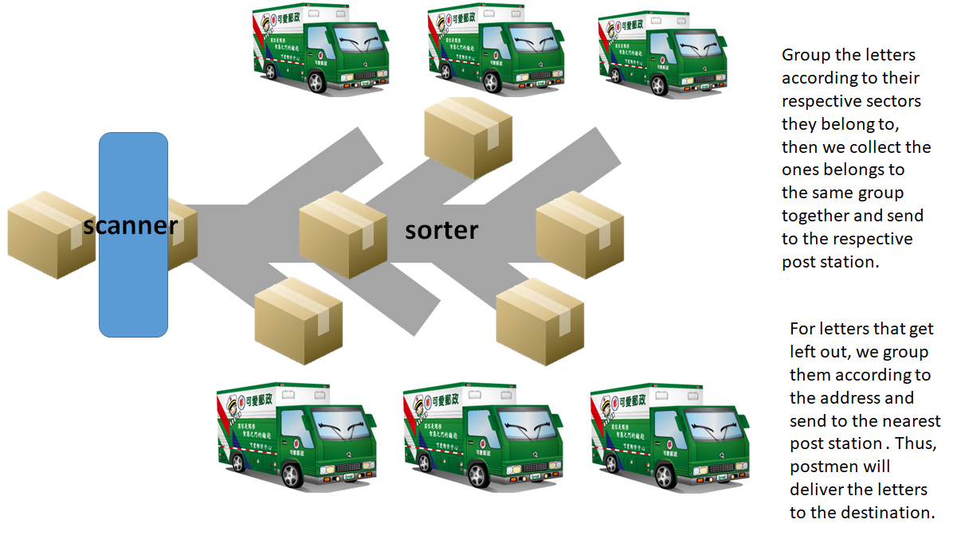
Sorting route

Slide 6
Before enhancement
Package/letter
info
Person in charge
include
include
Package size
1
Payment
Destination info
postman
include
include
sender
Urgent/normal
receipt
postman
Post office

Slide 7
Before enhancement
sender
Post office
postman
recipient
package size
Destination info
Urgent/normal
quotation
money
receipt
delivery
delivery
signature

Slide 8
After enhancement - package
Searching
destination
scan
Trucks
include
1
classification
packages
include
1..*
Weight
classification
conveyance
destination

Slide 9
After enhancement - letter
Searching
destination
Scan
include
Destination
1
Classification
Trucks
letters
1..*
Conveyance
Sorting system

Slide 10
After enhancement
postman
computer
conveyor
trucks
destination
scan
information
Destination
(Postal code)
Urgent/normal
Package/letter
Package/letter
Package/letter

Slide 11
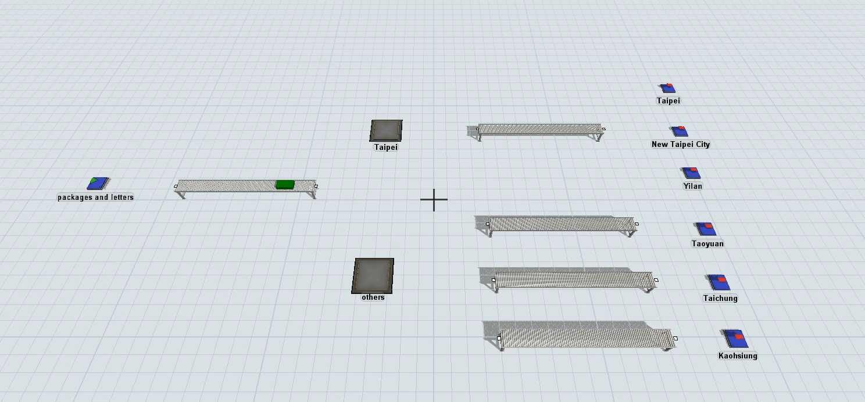
Flexslim demonstration

Slide 12
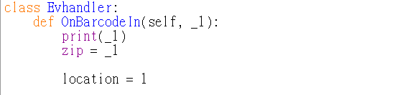
Classification program & Barcode scanning demonstration
There are 4 Mail Processing Center located at Taipei, Taoyuan, Taichung and Kaohsiung.
First, choose the Mail Processing Center where you are.

Slide 13
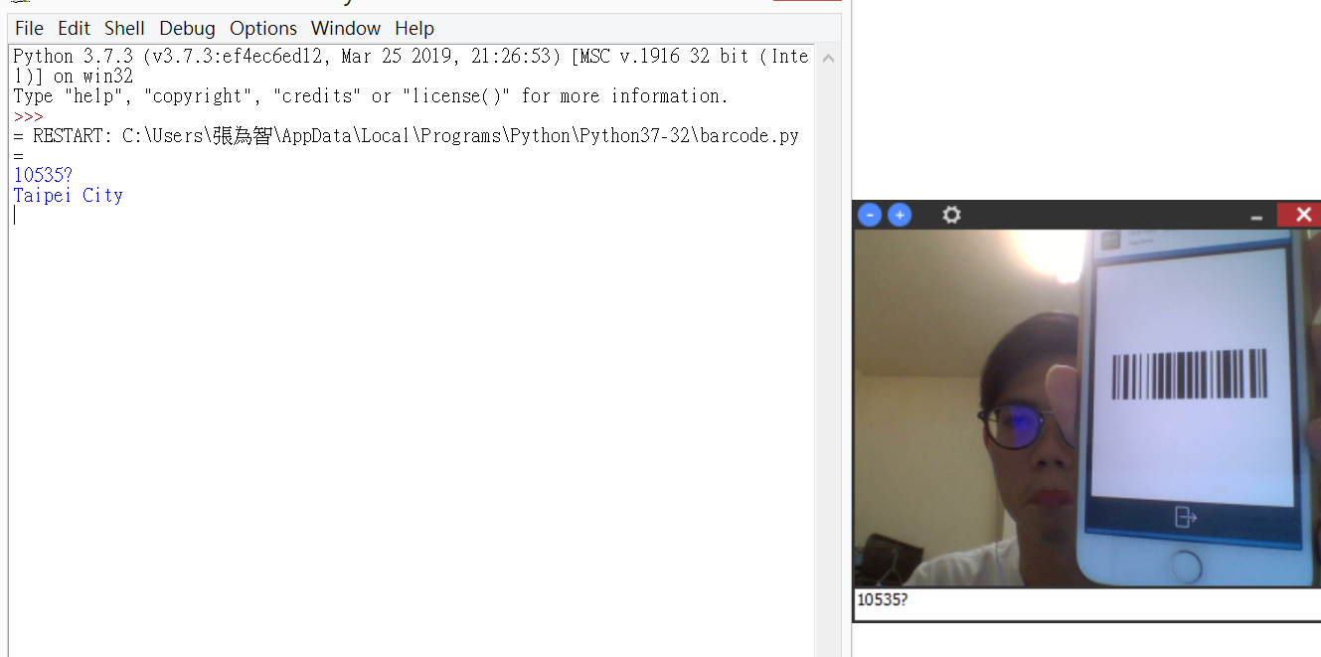
Classification program & Barcode scanning demonstration
Second,we scan the barcode and translate it into a string of 5 numbers.

Slide 14
Classification program & Barcode scanning demonstration
Third, output the destination where the letter should be sent to.

Slide 15
Relation between “location” & “result”
Location：Mail Processing Center
(1 for Taipei,2 for Taoyuan, 3 for Taichung, 4 for Kaohsiung)
Result：Destination
If the destination of the letter is belong to the responsible area of “location”, the “result” will be one of responsible area of this Mail Processing Center.
If the destination of the letter is not belong to the responsible area of “location”, the “result” will be one of the other Mail Processing Centers.

Slide 16
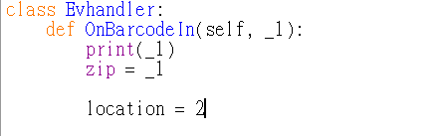
Relation between “location” & “result”— example
For example：
Set “location” as 2. That is, Taoyuan Mail Processing Center.

Slide 17
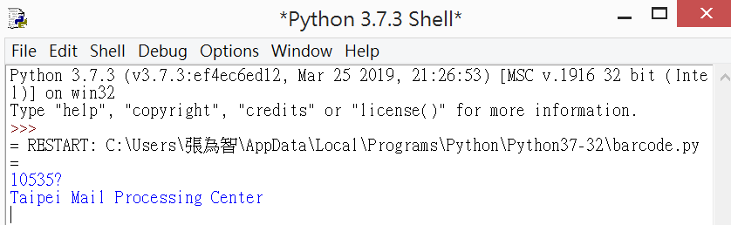
Relation between “location” & “result”— example
The zip code we got is “10535”.

Slide 18
Relation between “location” & “result”— example
Mail Processing Center | Responsible area ( surpose ) | First code
Taipei | Taipei City, Keelung City, New Taipei City, Yilan County, Lianjiang County | 1,2
Taoyuan | Hsinchu City, Hsinchu County, Taoyuan City, Miaoli County | 3
Taichung | Taichung City, Changhua County, Nantou County, Chiayi City, Chiayi County, Yunlin County | 4,5,6
Kaohsiung | Tainan City, Kaohsiung City, Hualien County, Taitung County, Penghu County, Jinmen County, Pingtung County | 7,8,9
Responsible area for each Mail Processing Center

Slide 19
Relation between “location” & “result”— example
The destination is belong to Taipei Mail Processing Center’s responsible area, so “result” is “Taipei Mail Processing Center”.

Slide 20
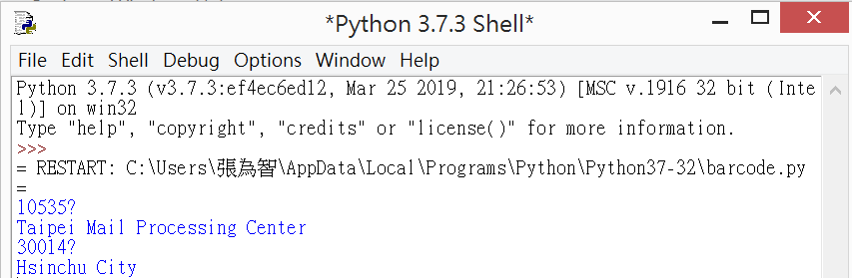
Relation between “location” & “result”— example
If the zip code we got is “30014”.

Slide 21
Relation between “location” & “result”— example
Mail Processing Center | Responsible area ( surpose ) | First code
Taipei | Taipei City, Keelung City, New Taipei City, Yilan County, Lianjiang County | 1,2
Taoyuan | Hsinchu City, Hsinchu County, Taoyuan City, Miaoli County | 3
Taichung | Taichung City, Changhua County, Nantou County, Chiayi City, Chiayi County, Yunlin County | 4,5,6
Kaohsiung | Tainan City, Kaohsiung City, Hualien County, Taitung County, Penghu County, Jinmen County, Pingtung County | 7,8,9
Responsible area for each Mail Processing Center

Slide 22
Relation between “location” & “result”— example
The destination is belong to Taoyuan Mail Processing Center’s responsible area, so “result” is “Hsinchu City”.

Slide 23
Demonstration

Slide 24
Thank you.

